Slide 1

Probabilistic Model Checking in Sports Analytics
By
Mahima Shah
Bharadwaj Mudumba

Slide 2
Index
Introduction
Model Checking
UPPAAL Introduction
Modeling – Timed Automata
Simulator, Concrete Simulator
Verifier - CTL
Challenges
Our Model
Conclusion
Future Work
References

Slide 3
Introduction to the Project
This project aims to formally verifies the system that predicts the score a team can make.
This system uses a Machine Learning Algorithm called Random Forest Regressor.
We will verify the system using a Model Checking tool called UPPAAL.

Slide 4
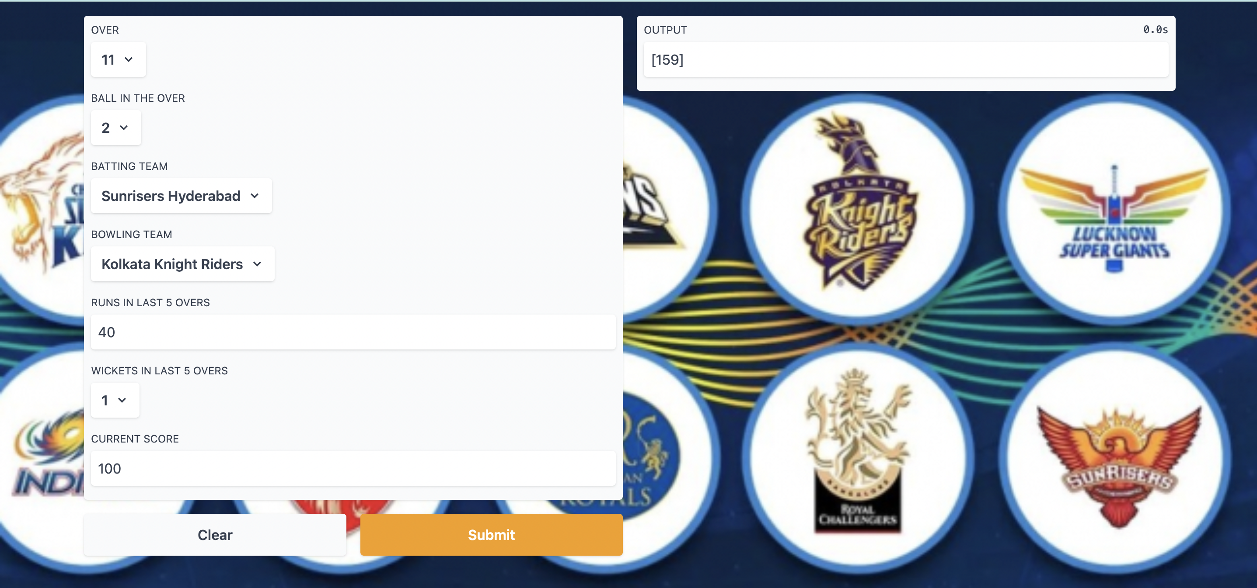
User Interface

Slide 5
Model Checking
It is a method to verify the completeness of the system.
It enables us to explore all possible future states from the current state.
The model checker takes the model and the properties of the system as an input. The output of the model checker is true if the property is satisfied otherwise, it generates the counter example

Slide 6
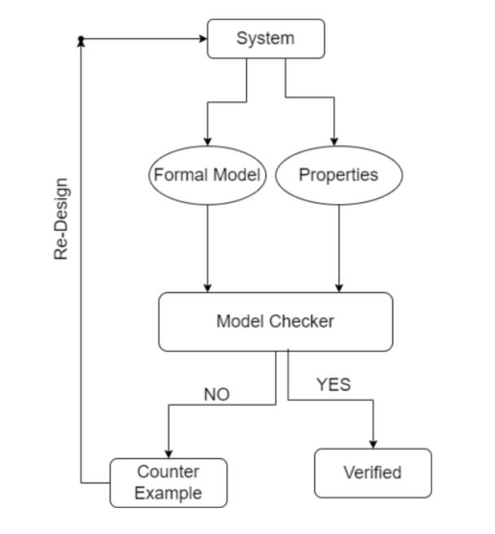
Model Checking

Slide 7
UPPAAL
UPPAAL is a tool for modeling, validation and verification of real-time systems.
UPPAAL has 4 components:
Editor
Simulator
Concrete Simulator
Verifier
We aim to verify the completeness of the system by applying model checking.

Slide 8
Modeling
In UPPAAL, we model using Network of Timed Automata.
Templates consists of Locations and the Edges connecting the locations.
Channels provides the synchronization among processes
We have converted the IPL Score prediction system into 4 templates:
User Interface,
Training,
Data Cleaning,
Random Forest.
Generally, we put each process in a template.

Slide 9
Overview of the templates
System starts at the User Inteface channel.
The data cleaning state in training channel will call data cleaning channel and returns the results to training channel.
The random forest channel will be initiated after the splitting state where the dataset is splitted in to training and testing data sets.
Once the user selects and inputs the valid data in all the fields it enters the training channel.

Slide 10
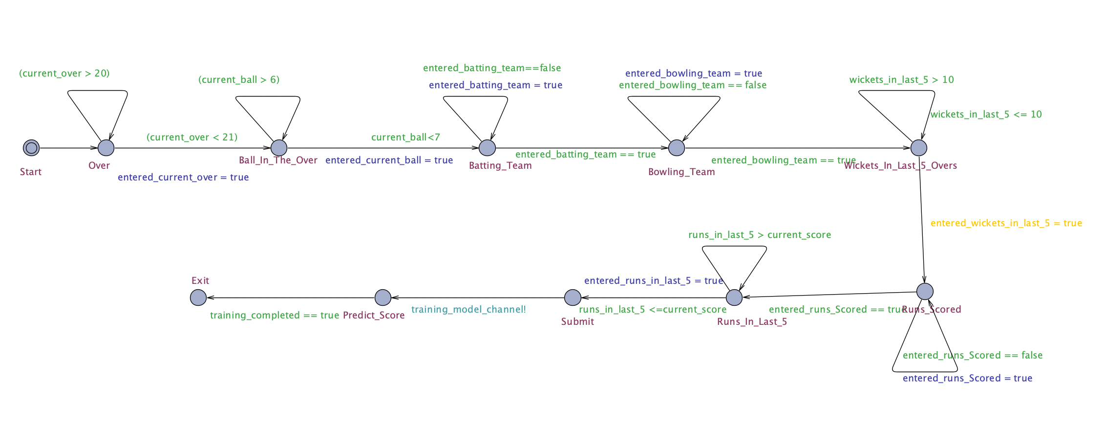
Templates - User Interface

Slide 11
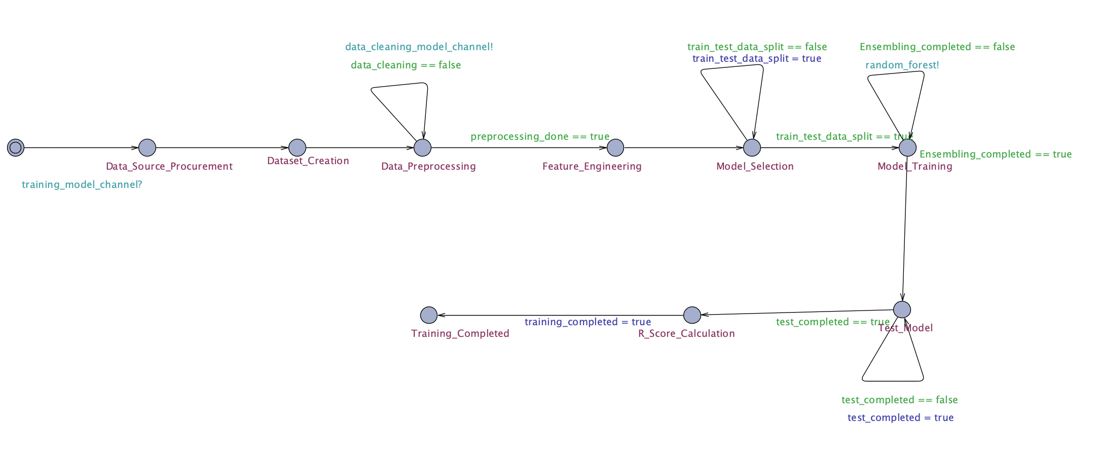
Templates – Model Training

Slide 12
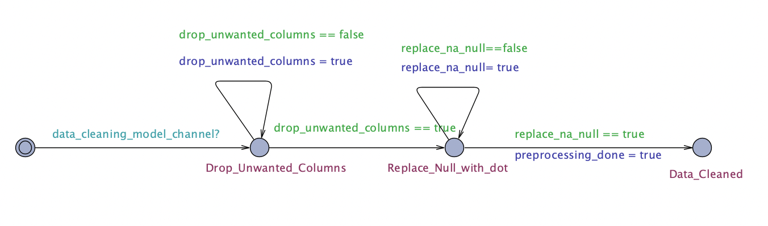
Template – Data cleaning

Slide 13
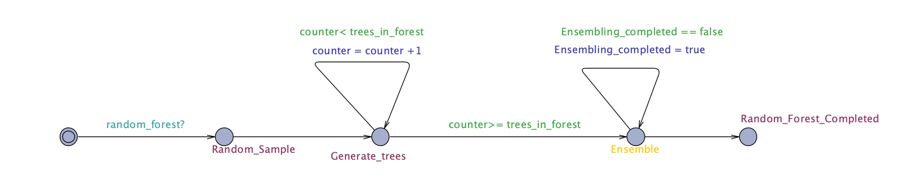
Template – Random Forest Regressor

Slide 14
Simulator
The simulator is a validation tool that enables examination of the possible dynamic executions of a system during early design (or modeling) stages.
The simulator enables to visualize executions through simulation trace and message sequence chart.

Slide 15
Concrete Simulator
The concrete simulator is similar to the simulator, the difference is that the simulation is based on concrete traces.

Slide 16
Verifier
Using verifier, we have verified the Safety and liveness properties of the system.
The properties to be verified must be written in computational Tree Logic and passed as query.
Computation tree logic has the temporal logic operators that can describes all the possible paths from a given state.

Slide 17
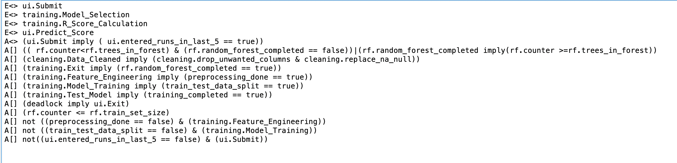
Safety, Liveness

Slide 18
Challenges
Choosing an appropriate tool to represent and verify our application.
Converting the system requirements representing in CTL.
Representing the application into UPPAAL.

Slide 19

Conclusion:
We have successfully implemented the model checking on our application and verified the properties of safety and liveness.
The following are some of the things we learned as a result of this project:
a. Learned about UPPAAL and how to represent our application in UPPAAL.
b. How to specify the requirements of the system.
c. The representation of the properties using computational tree logic.

Slide 20
Future Work:
This model is open for modifications with the changes to the application. Such as it allows number of balls in an over to be more than six, which is a possibility in case of wide ball or no ball in the over.
Little modification in the overs state enables us to predict the score of ODIs and various other formats.
Score prediction is also utilized in a wide range of sports. As a result, a similar model for verification using formal methods can be constructed for any sport.

Slide 21
References:
Uppaal. :: UPPAAL Documentation. (n.d.). Retrieved April 27, 2022, from https://docs.uppaal.org/
Features | UPPAAL. (n.d.). Mahima Shah and Bharadwaj Mudumba. Retrieved April 27, 2022, from https://uppaal.org/features/
Downloads | UPPAAL. (n.d.). Mahima Shah and Bharadwaj Mudumba. Retrieved April 27, 2022, from https://uppaal.org/downloads/

Slide 22
Q & A

Slide 23

Thank You

